Slide 1
PROJECT-4 repEAT website
Designed by
U.Yasaswini
Bharath Kumar
Chandana
Aravind Raj

Slide 2
Contents
Wireframe of website
About Website
Objective
SiteMap
Screenshots Of Webpages

Slide 3
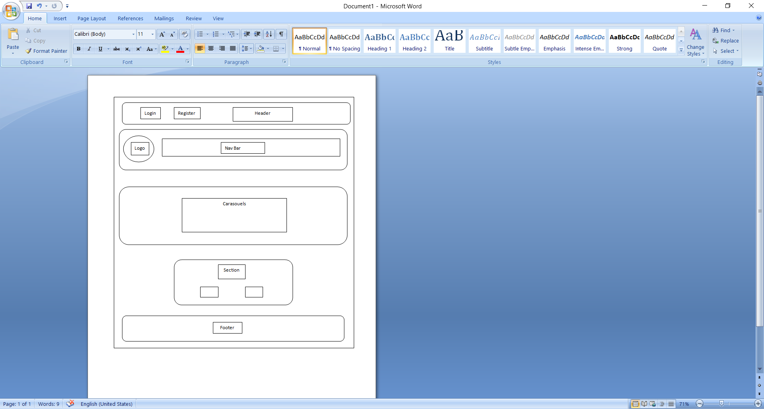
Wireframe of Website

Slide 4
About website
repEAT is a food ordering website which allows you to order different food items from various restaurants.
We are also providing another service like ordering groceries through our website.
repEAT have a proven track record of fast and safest delivery.

Slide 5
Objective
The Main objective of repEAT is to provide an essence of food ordering website via simple platform.
To design website we used HTML,CSS,Bootsrap

Slide 6
Sitemap
Home
Find Restaurants
Order Groceries
About Us
Contact us
Our Team
Hyderabad
Restaurants
Bangalore
Restaurants

Slide 7
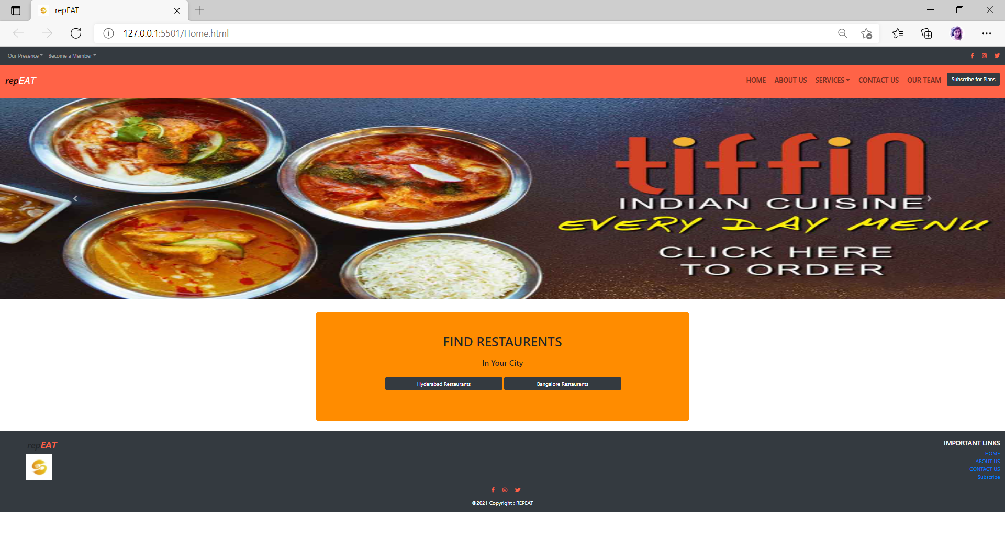
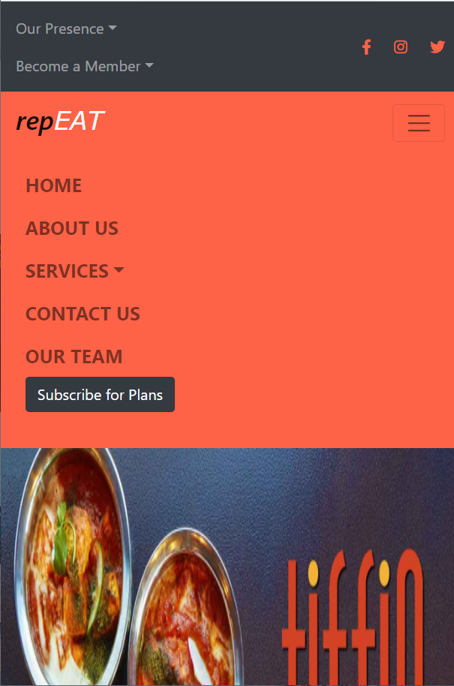
Screenshots of webpages
HOME PAGE

Slide 8
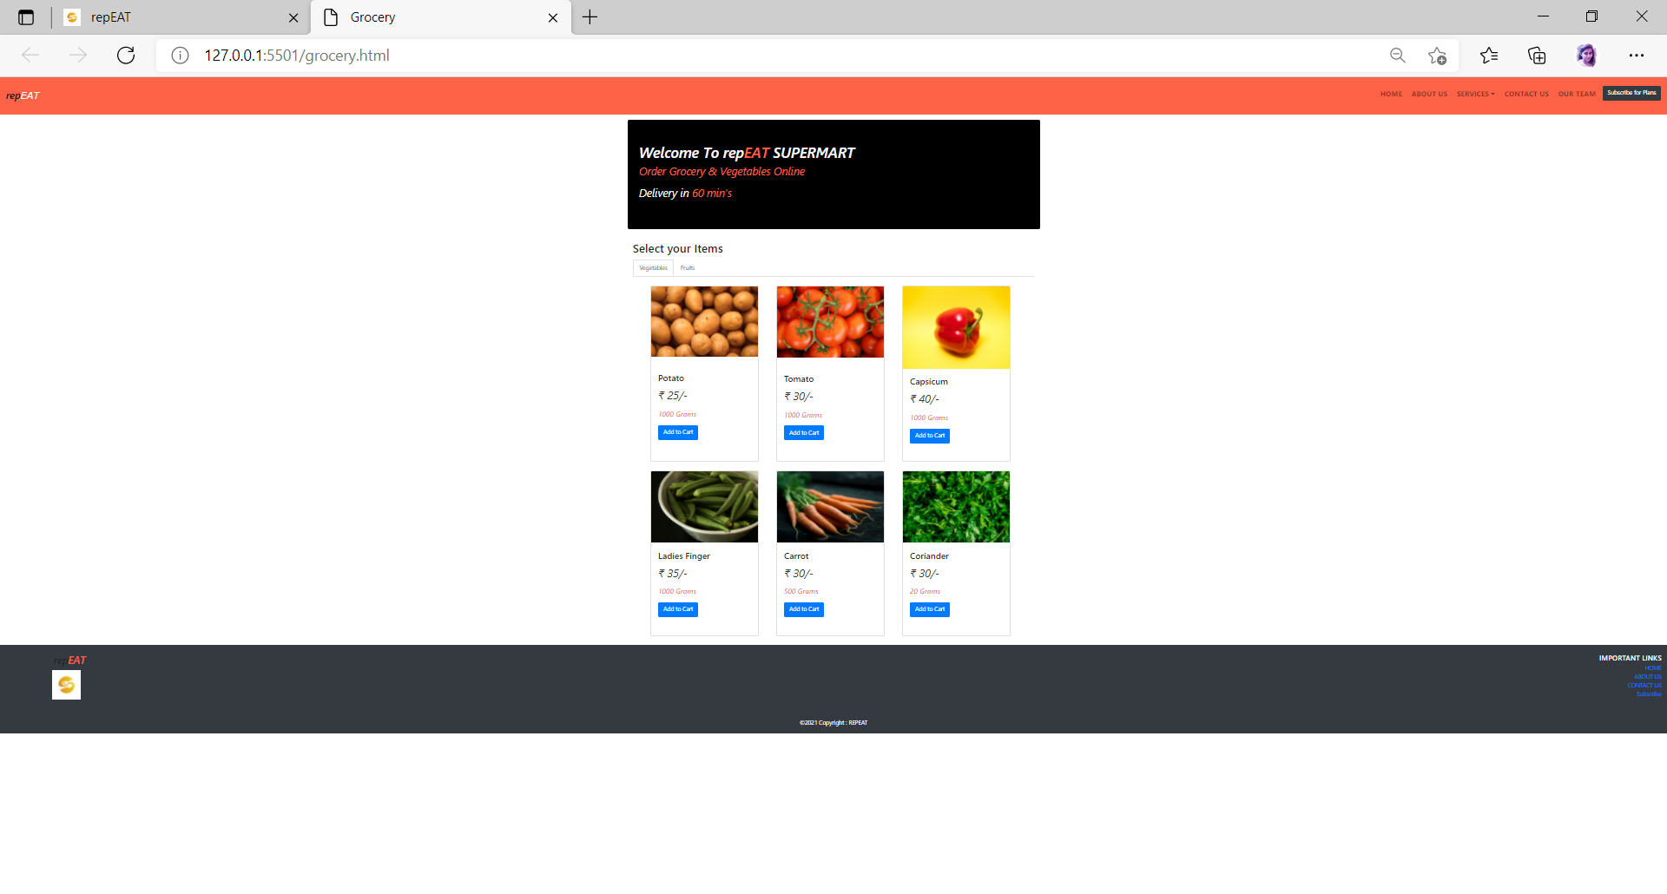
Groceries Page

Slide 9
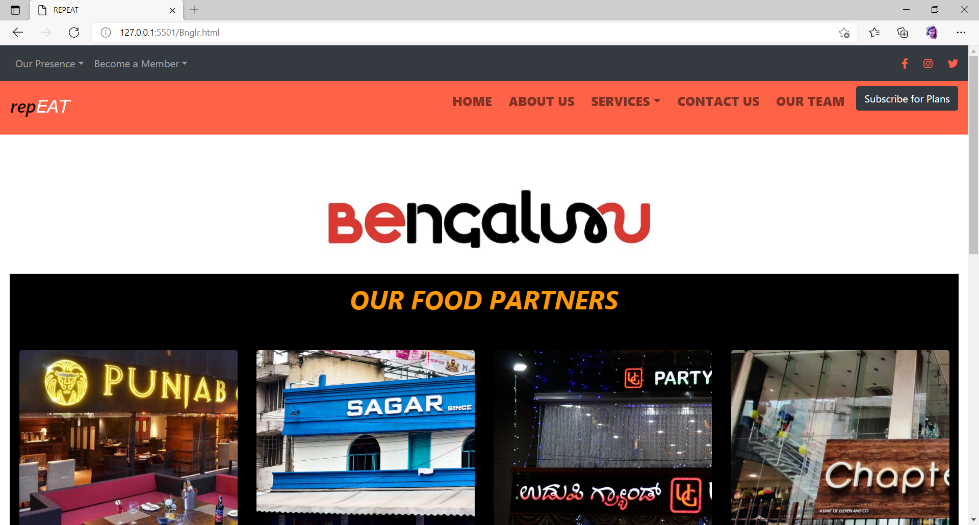
Restaurant Page

Slide 10
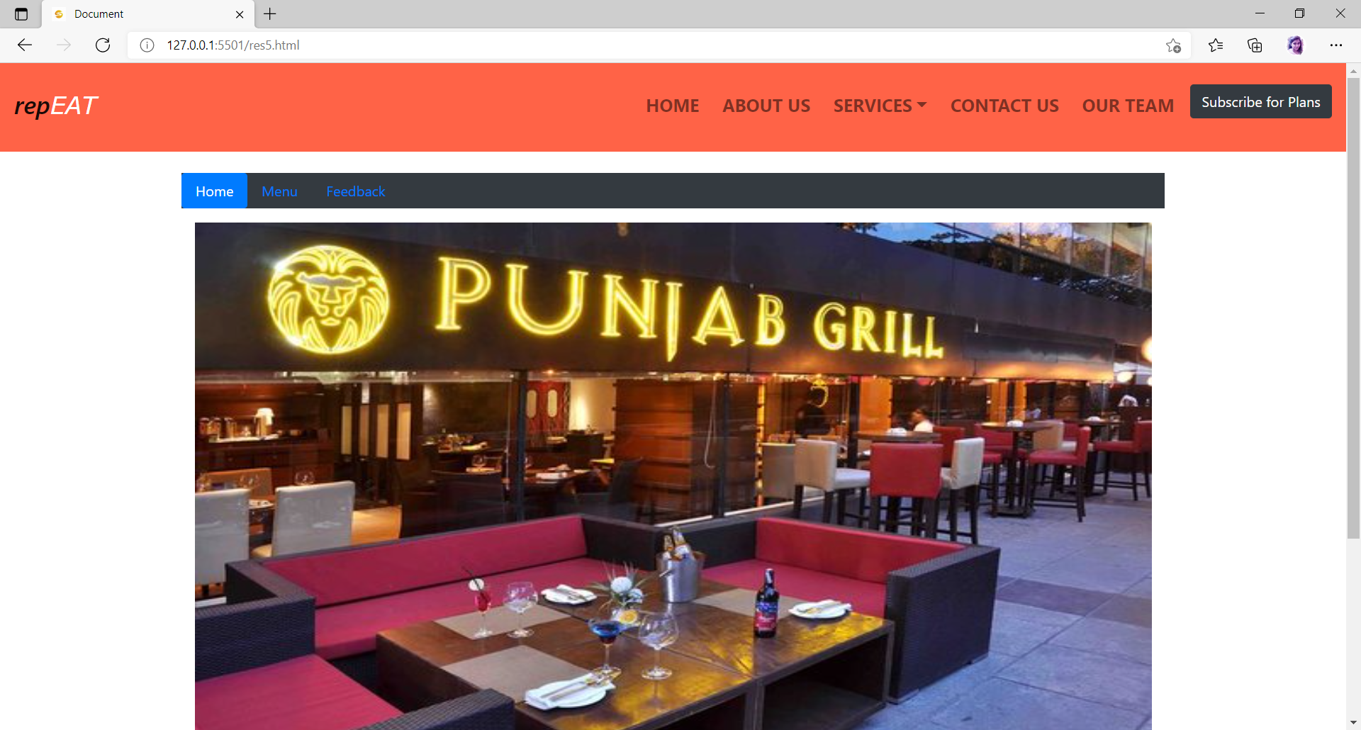
ordering Page

Slide 11
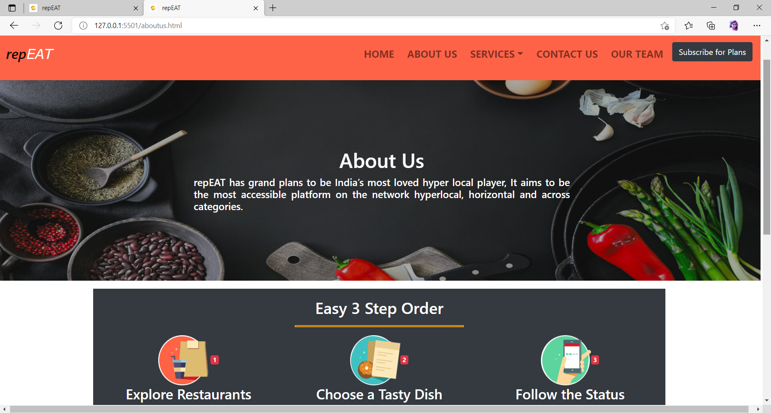
Aboutus Page

Slide 12
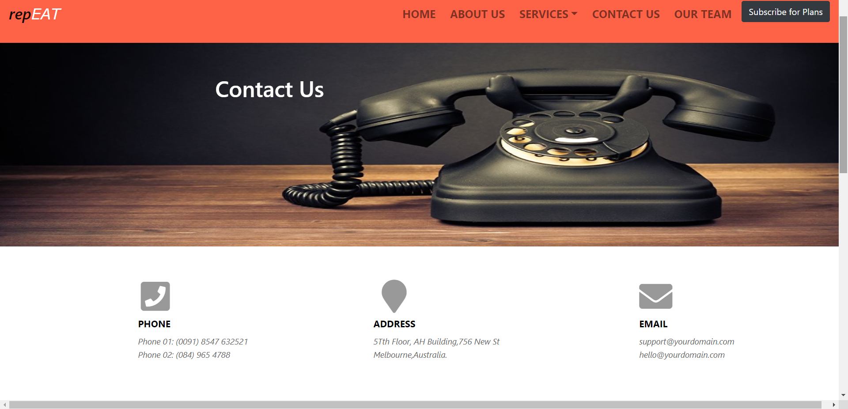
Contactus Page

Slide 13
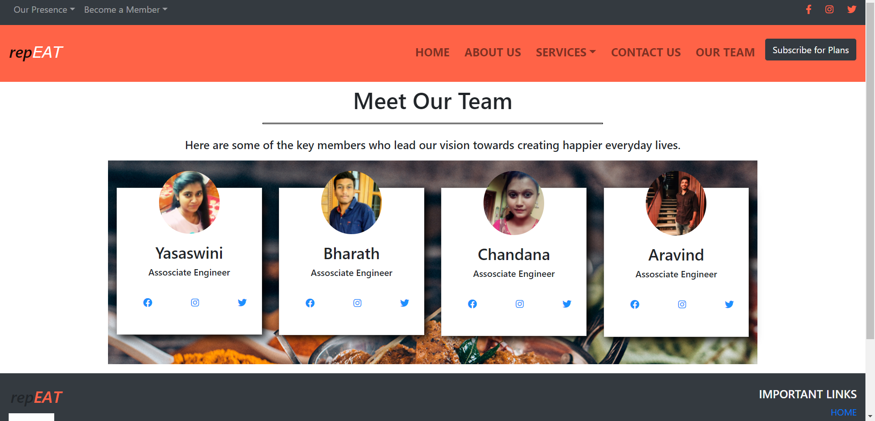
Ourteam Page

Slide 14


